Slide 1

(www.AMACFoundation.org)

Slide 2
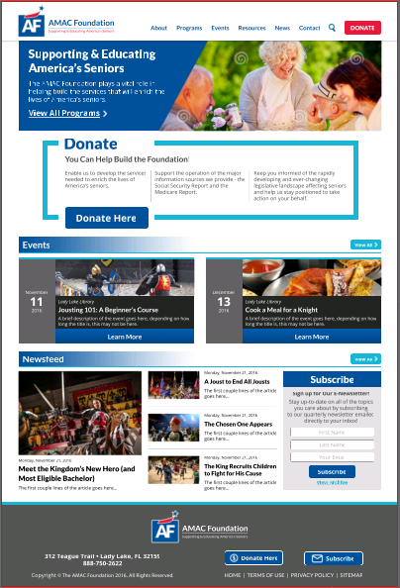

Slide 3


Medicare Report website (www.MedicareReport.Org)

Slide 4
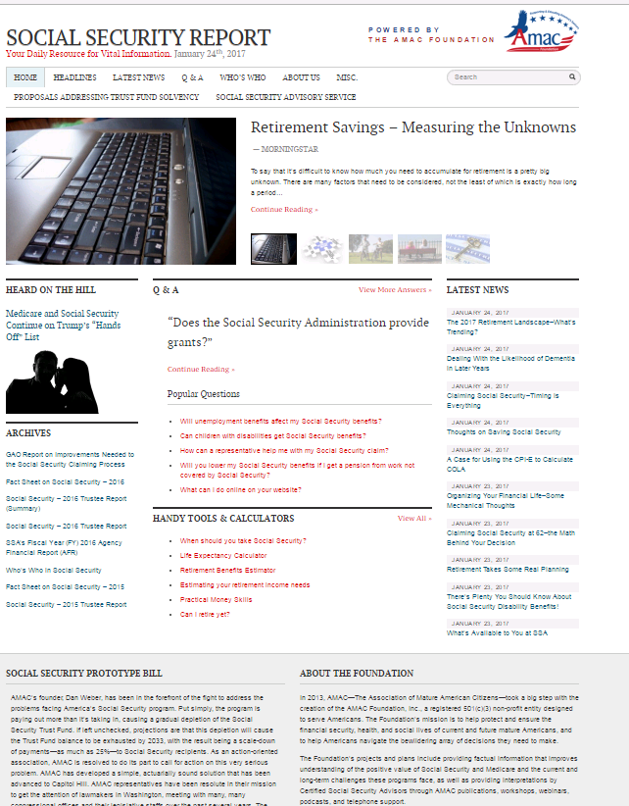
Social Security Report website (www.SocialSecurityReport.Org)

Slide 5
Social Security Advisory Service
Six NSSA-trained and Social Security Advisors
Geared toward anyone needing to understand their options
  Particularly critical to those ageing in
Questions can be submitted via website, telephone, email, or in-person
We’re now handling 200-300 inquiries per month
Learn more at: www.socialsecurityreport.org/about/social-security-advisory-service
Televised panel discussion set for Wednesday, February 7 (Attend or catch it live via our website:
  www.AmacFoundation.org/live

Slide 6
Today’s Workshop
“The Connected Home”

Slide 7
The Making of a Smart Home

Slide 8
What is a Smart Home?
A smart home is a home that has been equipped with lighting, heating, and other electronic devices that can be controlled remotely from a phone, tablet, or computer.

Slide 9
What Makes a Smart Home?
Lights
Light Switches and Outlets
Thermostats
Security Cameras
Video Doorbells
Locks and Garage Door Openers

Slide 10
Requirements
Some requirements to turn your home into a smart home are that you must have an active internet connection within the home, and you must have a smart device like a smartphone or a tablet.

Slide 11
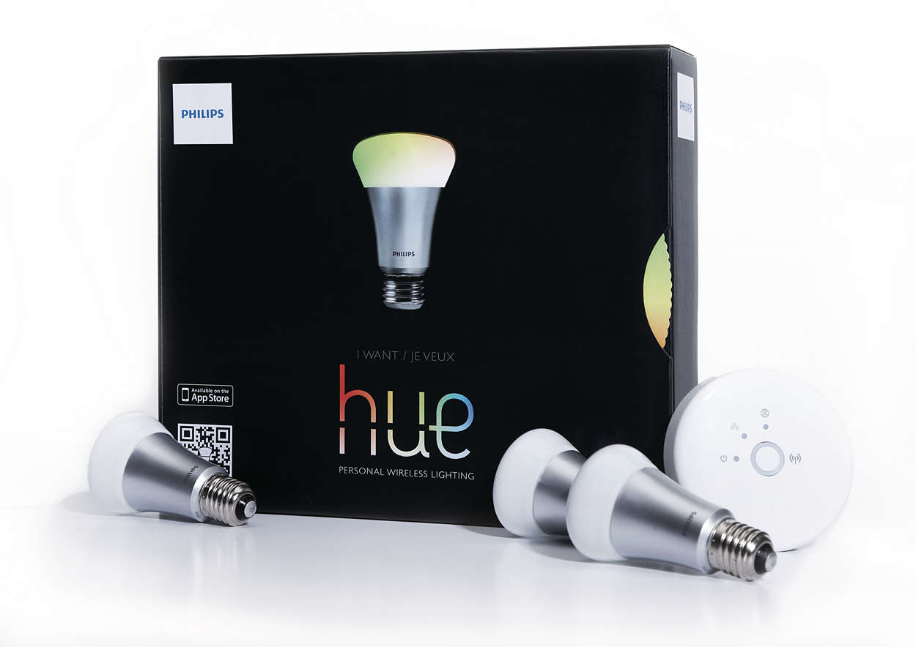
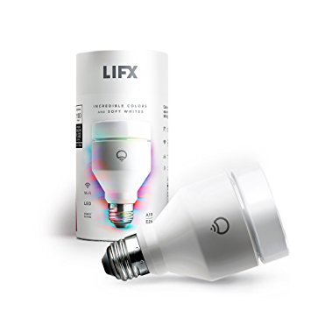
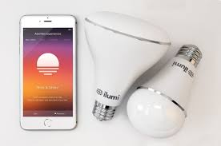
Lights
Philips Hue
Requires a Bridge
Adjustable brightness
Change colors (some models)
Led lights
  Longer lasting
  Creates less heat
  Energy efficient
Schedule and scenes
Light bulbs, light strips, accent lights, spot lights, floodlights
LIFX
No hub needed
Adjustable brightness
Change colors (some models)
Led lights
  Longer lasting
  Creates less heat
  Energy efficient
Schedule
Light bulbs, light strips, light bars, light panels
Ilumi
No hub required
No wifi required
Uses bluetooth mesh network
Adjustable brightness
Change colors (some models)
Led lights
  Longer lasting
  Creates less heat
  Energy efficient
Schedule
Light bulbs, light strips, spot lights, floodlights

Slide 12
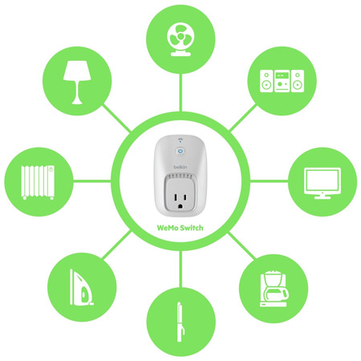


Light Switches and Outlets
WEMO
Smart plug
  Schedule
  “Away Mode” (Turns lights on and off)
Light switch
  Replaces existing light switch
  Schedule
  Backlit
Dimmer switch
  Night Mode turns lights on at lower levels at set times
TP-Link
Smart plug
  Schedule
  “Away Mode” (Turns lights on and off)
  Some have built in range extender
Light switch
  Replaces existing light switch
  Schedule
Lutron
Dimmer switch
  Automatically adjusts lights for changing seasons
  “Away Mode” (Turns lights on and off)
  Comes with remote for easy control

Slide 13
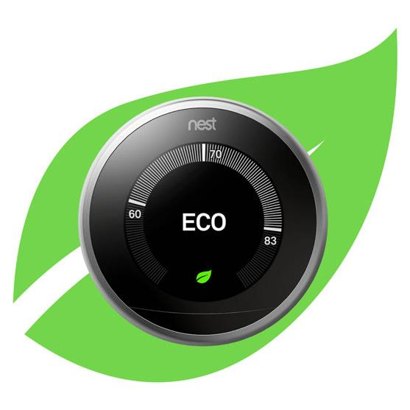
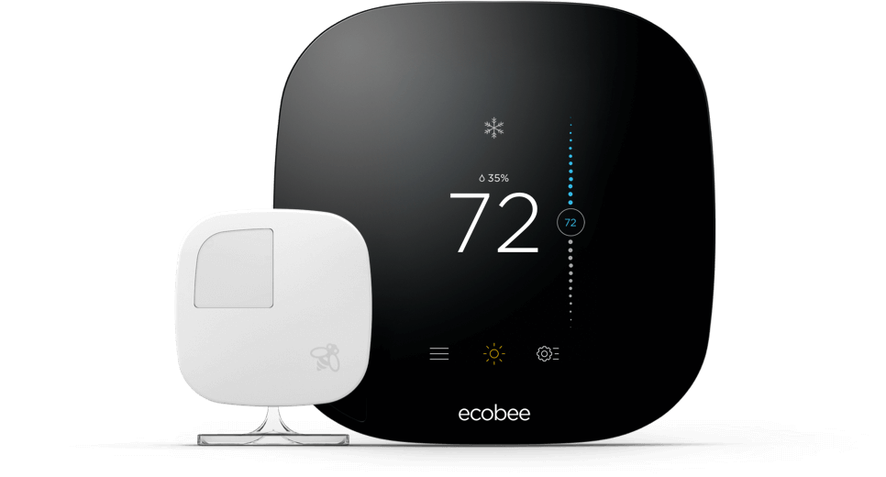
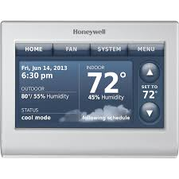
Thermostats
Nest
Farsight illuminates display when it sees you
Alerts you if something is working incorrectly
Learns your temperature patterns
Manages humidity and watches weather to adjust your homes climate
Tracks energy usage
Ecobee
Works with ecobee sensors to adjust for certain rooms
Uses local weather, your schedule, and desired settings to either keep you comfortable at home, or save money when away
Free monthly energy reports with tips to save more
Honeywell
Learns your temperature patterns
Alerts you when you need to change your air filter or humidifier pad
Alerts on extreme high or low indoor temperatures and humidity

Slide 14

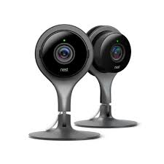
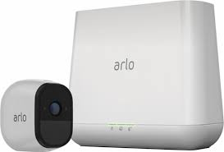
Security Cameras
Arlo Pro
Wireless Cameras
Indoor and outdoor
Rechargeable batteries
Free 7 day cloud storage
Built in siren
Local storage available
2-way communication
Motion detection
Night vision
130 degree viewing angle
Swann
Fully wired connection
Wifi only required for remote viewing
Weather-resistant
2tb of local storage
Night vision
Video outputs to connect a display
77 degree viewing angle
Nest
Wireless camera, but needs power
Have indoor and outdoor cameras
2-way communication
Night vision
Optional cloud recording (30 day trial)
130 degree viewing angle

Slide 15
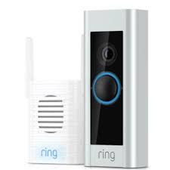
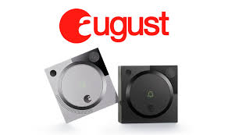
Video Doorbells
Ring
Motion sensor
Night vision
1080p HD
2-way audio
Can either use rechargeable battery or hardwired
Optional cloud recording
August
Motion Sensor
1280x960 HD
2-way audio
Hardwired connection only
Optional cloud recording

Slide 16
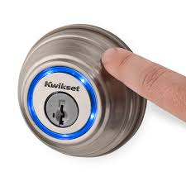
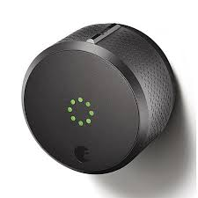
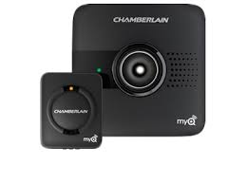
Locks and Garage Door Openers
Kwikset
Different versions include touch-to-open or touchpad/touchscreen
Battery operated
Replaces existing deadbolt
Touch-to-open and touchscreen lock uses bluetooth to unlock if your phone is near
Schedule lock periods
View lock history from your phone
August
Battery operated
Replaces existing deadbolt
Automatically unlocks when phones nearby, and locks behind you
Create virtual, time sensitive, keys for guests to enter
View lock history from your phone
Chamberlain MyQ
Uses a wifi hub
Works with most garage doors opener made after 1993
Allows you to grant access to guests to open your garage door
Activity alerts
Schedule when to close your garage door

Slide 17
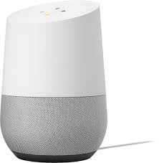
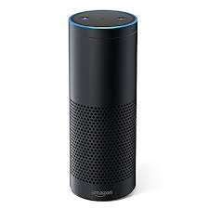
Smart Assistant
Google Home
Primary search engine: Google
Send asked for information to your phone
Find your phone by ringing it
Hands free calling
Google Play Music alongside services like spotify and pandora
Can control other Google based items like a Chromecast
Customizable appearance
Amazon Echo
Primary search engine: Bing
Hands free calling
Amazon Music alongside services like spotify and pandora
Can read your kindle books to you, or your audio books
Most models act as a bluetooth speaker
More than 10,000 skills (third-party, voice enabled apps for the Echo)

Slide 18
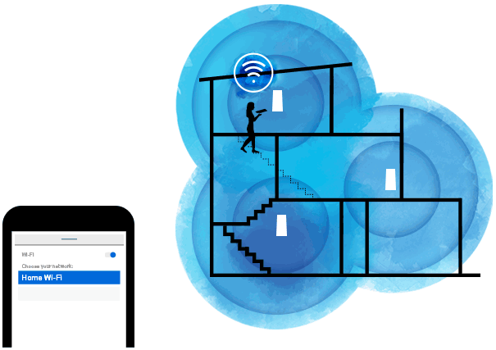
Wireless Router
Mesh Network
Great for larger homes over 2,000 sq ft
Better than standard routers for homes made with brick or other solid material
Mesh networks don’t drop signal between access points unlike wifi extenders
Can fix wifi dead spots in most homes

Slide 19
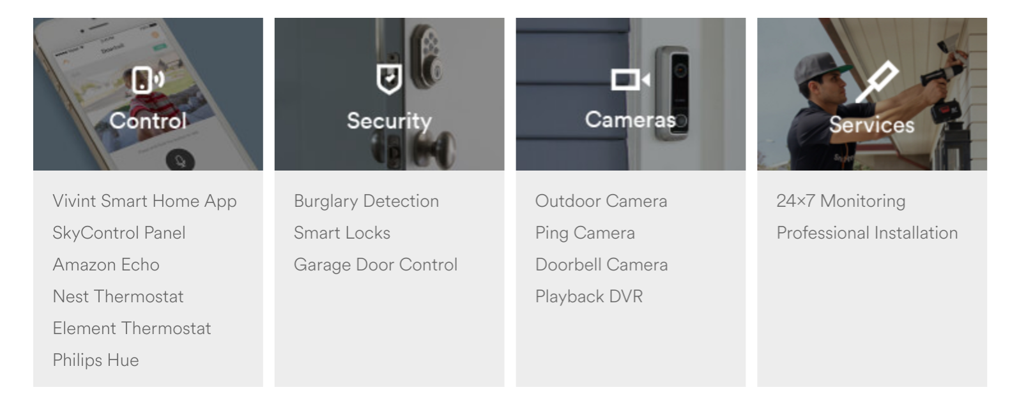
Vivint

