Slide 1


(www.AMACFoundation.org)
(www. www.vitas.com)
Today’s Seminar:
“Caring for the Caregiver”

Slide 2
(www.AMACFoundation.org)
(www. www.vitas.com)
First, A Word From
Your Sponsors…

Slide 3
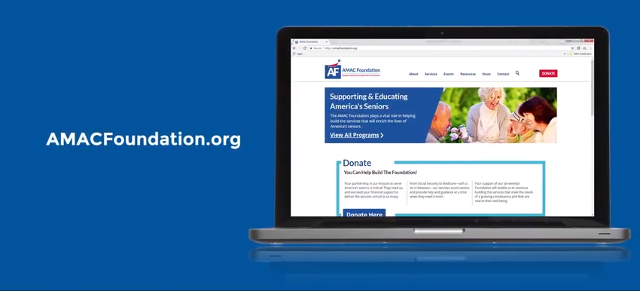
https://youtu.be/Ayr7pXFpALs

Slide 4

(www.vitas.com)
https://www.youtube.com/watch?v=oPQwO9UUrMI&sns=em

Slide 5
More than ¼ of American adults have been Caregivers
Male/Female ratio: 44%/56%
Over half of Caregivers are between ages of 35 & 64
Half of those over 85 need care
By 2025, well over 50 million Americans will be in need of care
Some Statistics…

Slide 6
What we’ll cover today:
Part 1 – Introduction, Roles, Caregiver Bill of Rights, Coping with the challenges
Part 2 – Stress: Responses and Remedies; Avoiding Burnout
Part 3 – Senior Safety
Part 4 – Wrap-up and Concluding Remarks
“Caring for the Caregiver”

Slide 7



